Slide 1

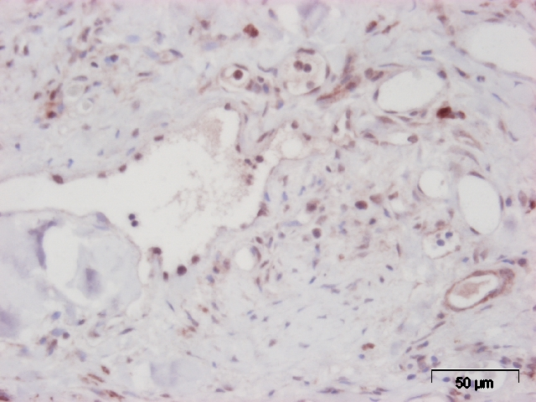
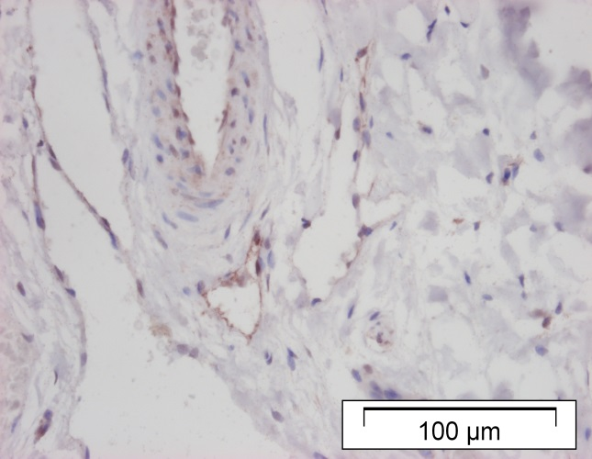
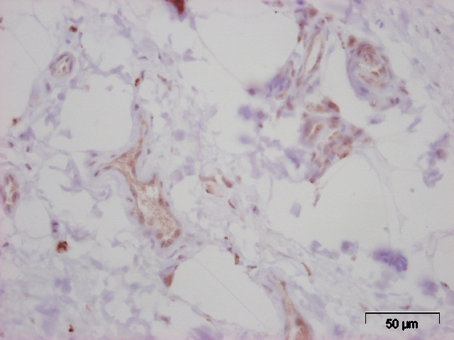
ReliaTech GmbH
Rabbit anti-human LYVE-1
(Cat #102-PA50AG)
A
B
C
Immunohistochemical staining of the lymphatic vessels with anti-human LYVE-1 polyclonal antibody. (A) malignant canine mammary tumor; (B) benign canine mammary tumor; (C) normal canine mammary gland tissue.
The experiment was performed by the research group of Applied Veterinary Morphology – University of Antwerp
http://www.reliatech.de / orders@reliatech.de

